Slide 1
Show me, don’t tell me: Sprint 4 Demo
16 November 2021

Slide 2
Sprint 4 Approval (1 of 2)
CLIN 0001AB
Sprint Dates: 11/3/2021-11/16/2021
Sprint Goals: Make demonstrable and meaningful progress on delivering the Health Apartment POC design. Recruit, hire, and onboard both FTEs (prime or subcontract) to address open roles and bring in additional capabilities to move the work forward in the interim. Develop a product strategy / roadmap to guide us to POC design and MVP design and development.
Priority | Epic - User Story | Acceptance Criteria
High | POC Design: Create product roadmap and backlog Deliverable: Refined product roadmap, owners aligned with user stories / issues | Working sessions on Product Roadmap scheduled and conducted with PO and capability leaders across broader MO team. Activities, components and features prioritized to drive team from vision to POC Design provided by VA PO. Working sessions conducted to turn provided activities into a visual Product Roadmap with assigned owners of artifacts. Product roadmap driving team to POC Design developed, socialized, and approved by VA PO; team aligned around roadmap and focus. Product backlog in ZenHub evolved including epics, user stories and issues, acceptance criteria, and sizing to drive team to POC Design.
High | POC Design: Create POC Design prototypes (low level of fidelity) Deliverable: Design Prototype (low-fidelity); 18 frames | VA PO and design lead engaged to deep dive current state of POC design, wireframes, and transition ownership to MO. POC components, features, and UX prioritized building off of work done to date by design lead and VA.gov flagship mobile app team. Low level fidelity prototypes (Procreate software) created for ~18 frames of prioritized components, features, and UX to gather input and align on design intent efficiently (i.e., build to learn): (1) POC landing page; (2) health care homepage; (3-11) authenticated and (12-21) non-authenticated top landing pages from sitemap including Pharmacy, Messages, Appointments, Records, Copays and Travel Pay, Health Care, Health Supplies, Track and Research Health, Health and Resources. Feedback gathered during APT POC & MVP weekly check-in and demo and captured in backlog to be incorporated into mid level of fidelity prototypes.
Medium | POC Design: Discovery and exploration on navigation system Deliverable: Key insights and opportunities for navigation system captured in shareable artifact (e.g., Mural board). | Navigation system content reviewed (e.g., VA.gov healthcare section, navigation mural, design system, PA CMS, VA.gov healthcare benefit hub). Key insights and design opportunities captured in Mural board and shared with product team; insights and opportunities fed into backlog for mid-level fidelity prototypes.
Notes:
Evolve GitHub Repo and documentation templates for POC
Test low-fidelity prototype with users

Slide 3
Sprint 4 Approval (2 of 2)
CLIN 0001AB
Sprint Dates: 11/3/2021-11/16/2021
Sprint Goals: Make demonstrable and meaningful progress on delivering the Health Apartment POC design. Recruit, hire, and onboard both FTEs (prime or subcontract) to address open roles and bring in additional capabilities to move the work forward in the interim. Develop a product strategy / roadmap to guide us to POC design and MVP design and development.
Priority | Epic - User Story | Acceptance Criteria
Medium | Collaboration Cycle: Product Definition Document Deliverable: Product Definition Document reviewed and suggestions and edits provided. | Product Definition Document reviewed and actionable feedback provided from core and extended team members (capability SMEs). Feedback consolidated and Product Definition document evolved by VA PO. Impact on product roadmap including POC Design and MVP Design and Development determined and added to backlog for future consideration. VA PO engaged to determine owner and governance of Product Definition Document moving forward.
Medium | Collaboration Cycle: Initiation Deliverable: Initiate Collaboration Cycle through VA PO | Research collaboration cycle and captured epics and user stories for product backlog. Collaboration Cycle started by VFS Product Owner submitting design intent ticket. Working session with VA PO to align on Collaboration Cycle next steps and clear owners scheduled.
Notes:
Evolve GitHub Repo and documentation templates for POC
Test low-fidelity prototype with users

Slide 4
Sprint 4 Mid-Sprint Add On
CLIN 0001AB
Epic - User Story | Fibonacci Seq. | Acceptance Criteria | Notes | Date
POC Design: Determine impacts to POC design through Tree test results | N/A | Validate study result parameters compliance Review and synthesize objective & subjective data from Tree Testing Report impacts to POC design development team | Low priority add-on, will address if excess capacity or return to Product backlog. Interim results will be added to low-fidelity frames. | 11/9/21

Slide 5
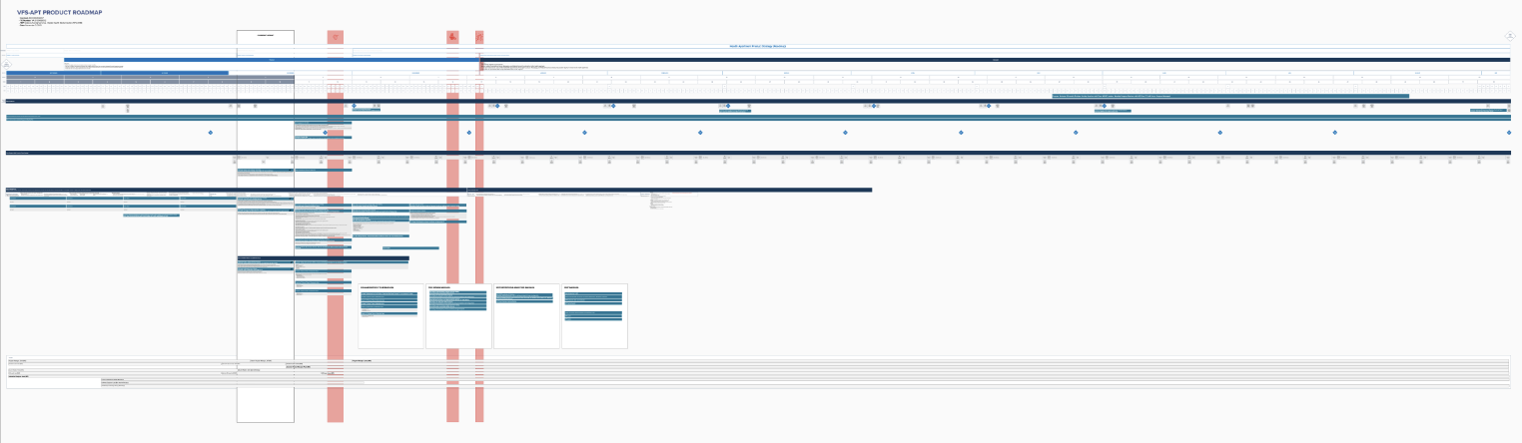
POC Design: Create product roadmap and backlog
CLIN 0001AB
Deliverable: Refined product roadmap, owners aligned with user stories / issues
Scheduled and conducted Product Roadmap working sessions on with VA PO and delivery team.
Prioritized activities, components, and features to drive team from vision to POC Design provided by VA PO.
Built off CEDAR VFS-DHM proposed approach and VA Digital Service Handbook (including Collaboration Cycle and MVP definition guidance) into Product Roadmap.
Assigned owners to epics to facilitate alignment and accountability on the cross-functional delivery team.
Socialized Product Roadmap and refined based on VA PO feedback here.
Aligned team on plan / epics to drive to POC Design and MVP Development (e.g., epics, governance, stakeholder engagement via Working Group, CEDAR program, staffing across roadmap for entirety of PoP).
Evolved Zenhub product backlog to Mural during this design phase (i.e., deferred reliance on ZenHub until development phase) to support alignment on epics, acceptance criteria, and sizing.

Slide 6
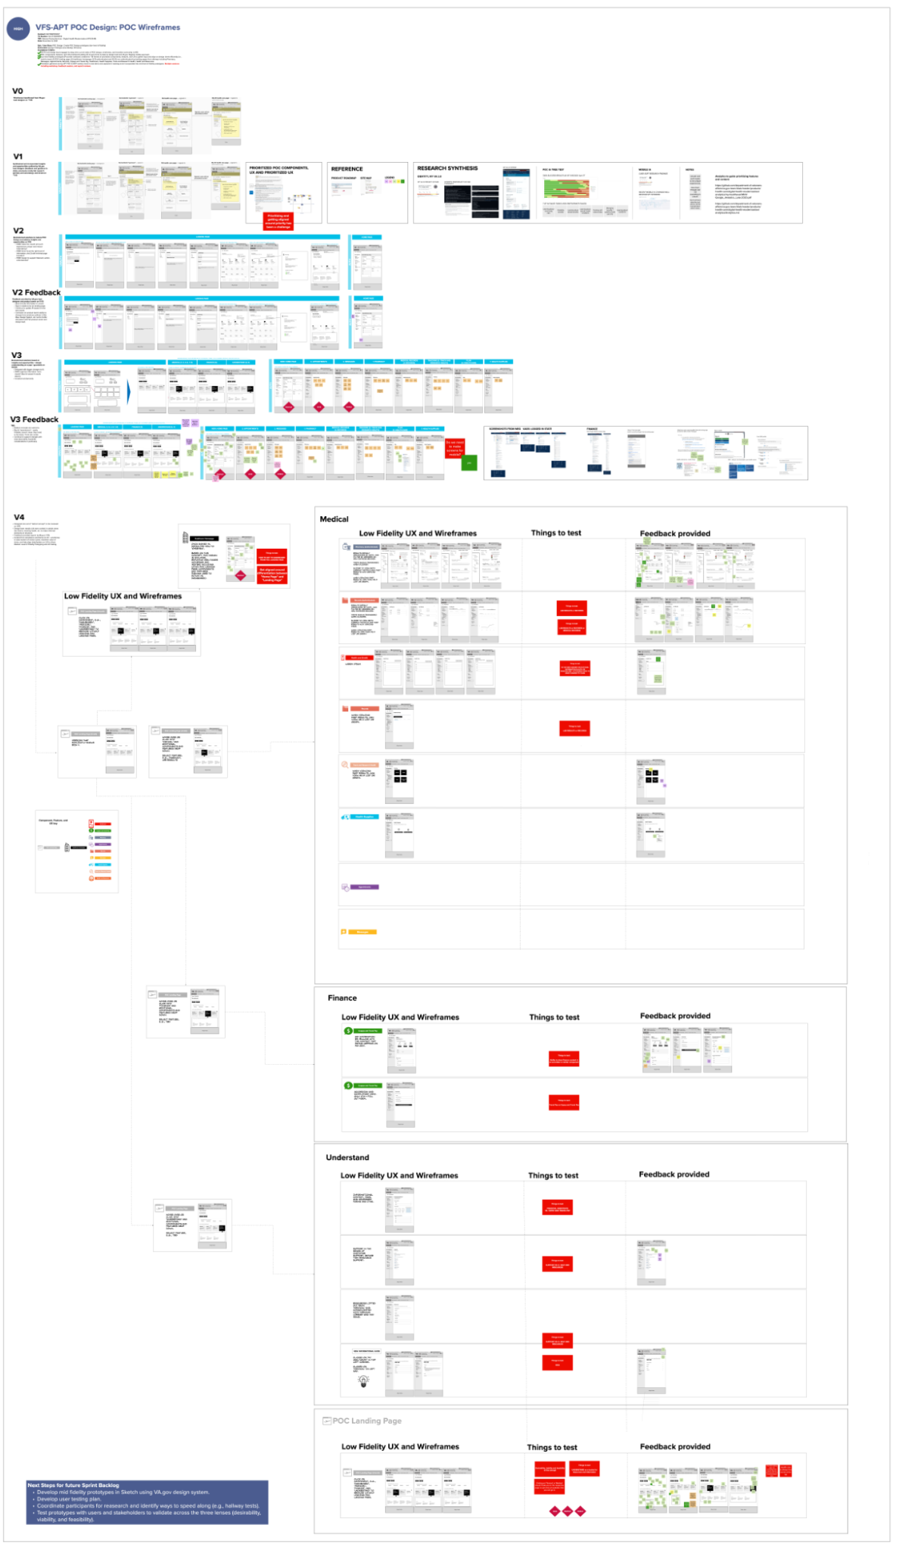
POC Design: Create POC Design prototypes (low level of fidelity)
CLIN 0001AB
Deliverable: Design Prototype (low fidelity); 18 frames
Transitioned POC design wireframes from VA Design Lead to MO to own and drive forward.
Gathered input from VA PO and VA Design Lead on reprioritization of POC components, features, and UX.
Infused insights from preliminary IA tree test results as well as additional secondary research studies (VA.gov Mobile App card sort) into concepts and designs.
Brainstormed solutions to address design questions and user feedback and pain points.
Created 27 wireframes for authenticated and non-authenticated low fidelity wireframes (view here).
Gathered feedback from VA PO and VA Design Lead during multiple sessions (including POC and MVP weekly check-in and demo).
Incorporated feedback into iterative low fidelity wireframes and captured additional feedback as backlog items for mid fidelity wireframes.
Mapped out initial user experience flow of future-state vision to accompany wireframes.

Slide 7
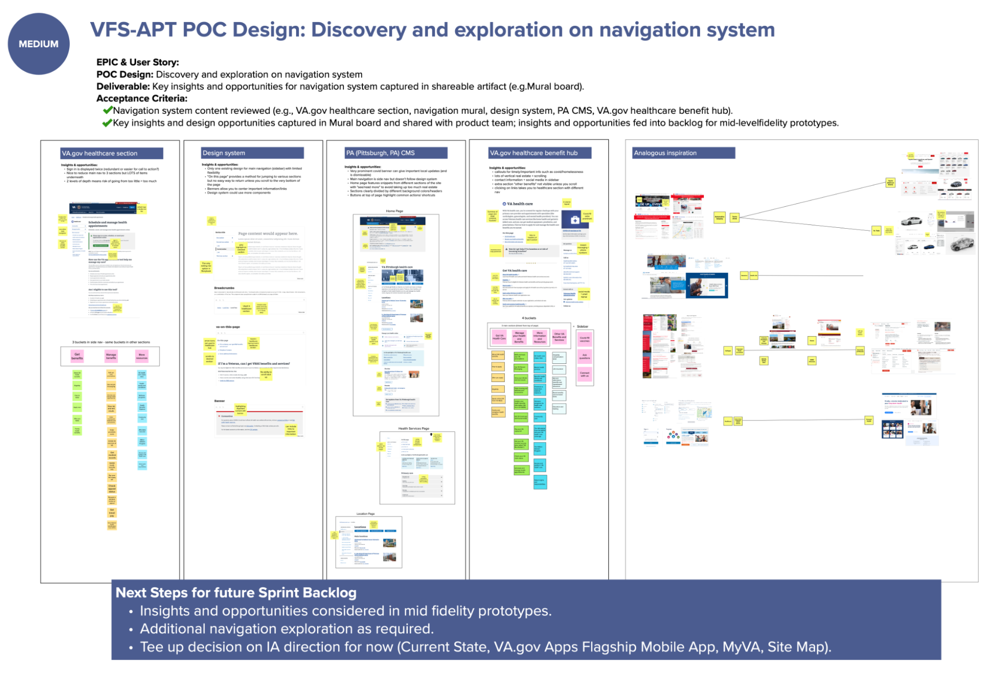
POC Design: Discovery and exploration on navigation system
CLIN 0001AB
Deliverable: Key insights and opportunities for navigation system captured in shareable artifact (e.g., Mural board)
Reviewed Navigation system content from relevant sites, including VA.gov healthcare section, navigation Mural, VA design system, PA CMS, and VA.gov health care benefit hub.
Identified patterns, insights, and design opportunities to infuse into mid fidelity prototypes, and captured in a Mural board and backlog shared with product team.
Researched analogous use cases to inspire navigation design and potential solutions.

Slide 8
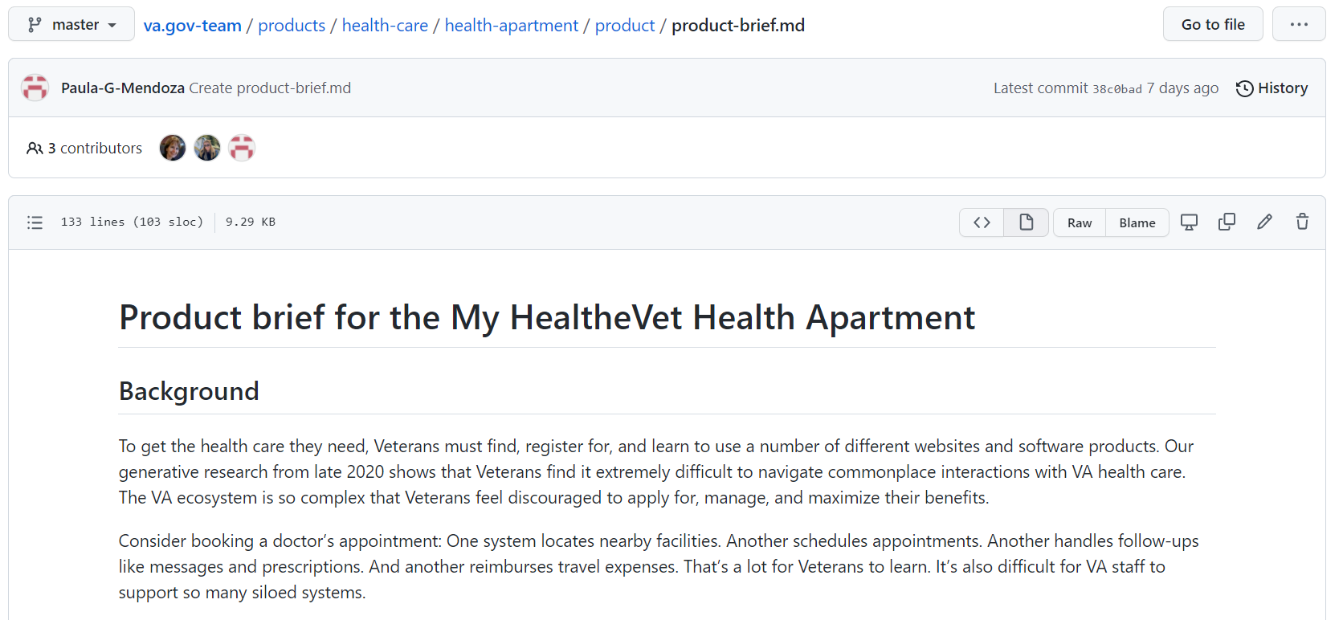
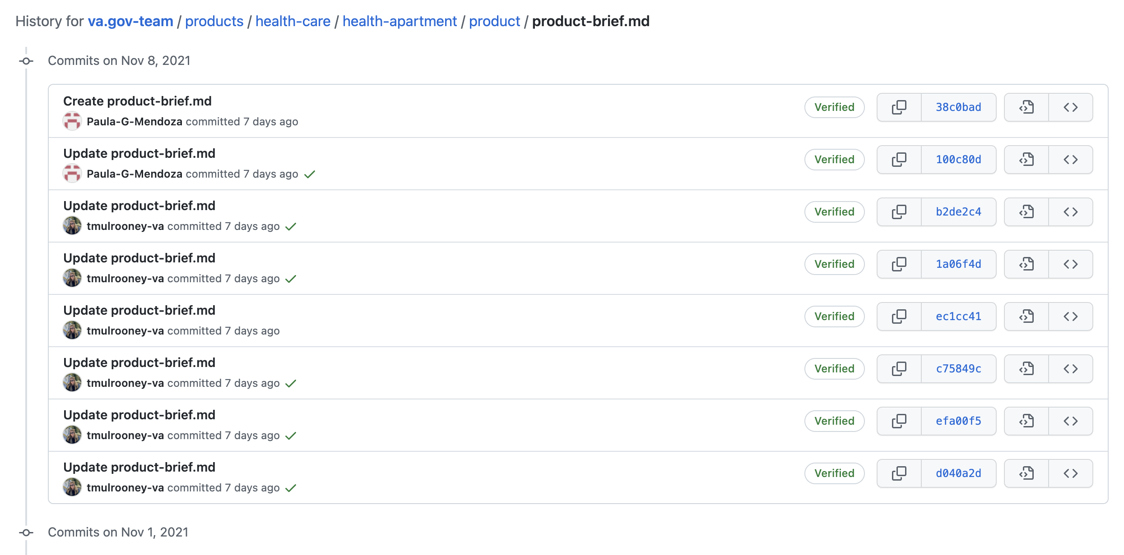
Collaboration Cycle: Product Definition Document
CLIN 0001AB
Deliverable: Product Definition Document reviewed and suggestions and edits provided
Reviewed Product Brief (i.e., Product Outline) and provided actionable feedback.
Consolidated feedback and evolved document by VA PO.
Determined and mapped its impact (and that of the associated Collaboration Cycle) on product roadmap, including POC Design and MVP Design and Development.

Slide 9
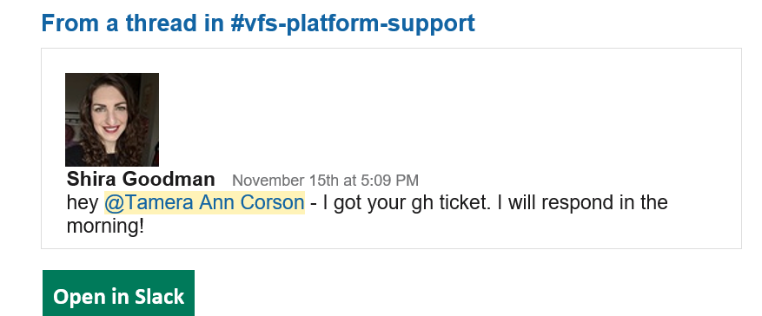
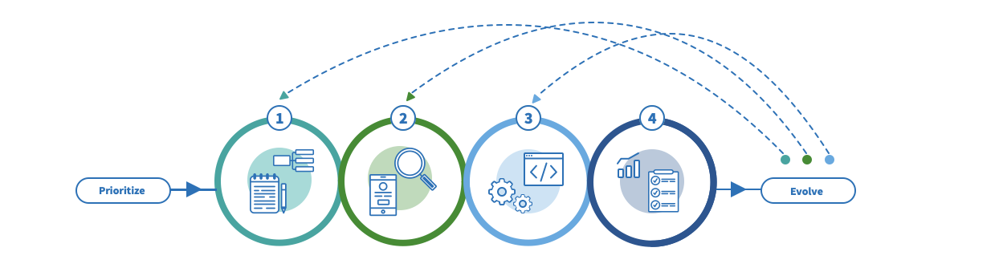
Collaboration Cycle: Initiation
CLIN 0001AB
Deliverable: Initiate Collaboration Cycle through VA PO
Researched Collaboration Cycle on VA Platform website and reflected epics in product roadmap.
Completed and submitted Pre-Collaboration Cycle Kick Off questionnaire.
Initiated Collaboration Cycle via ticket submission on #vfs-platform-support Slack channel and GitHub; ticket #32870)
Scheduled working session with VA PO in next sprint to align on Collaboration Cycle next steps, owners, and governance (including Product Outline document).

Slide 10
End of Sprint 4 Update
CLIN 0001AB
The team’s accomplishments this sprint include:
Design Prototype
Wireframes transitioned from VA.gov lead designer on ~11/8
Synthesized and incorporated insights and opportunities outlined by VA.gov lead designer (feedback and guidance to date), previously conducted research (primary and secondary), and IA test on ~11/9
Brainstormed solutions to mature POC Design and address insights and opportunities on 11/9
How may we (HMW) make the unauth and auth experiences unique and reduce redundancy?
HMW show 1) just the right level of information, and 2) with minimal page transfers?
HMW design to support Veterans' action-orientedness?
Feedback provided by VA.gov lead designer and product owner on 11/10
Must include information in unauth.
Sign in needs to be on landing page.
Continue to update IA based on tree test results.
Confusion on product team's ability to diverge from solutions outlined in Site Map, Design System, etc. led to fruitful discussion with VA product owner and design lead.
Brainstormed solutions based on insights and opportunities + deeper understanding on scope / guardrails on 11/12.
Designed with bigger changes to IA.
HMW organize information more clearly? (See IA research results above.)
Included red diamonds
Version 3 produced, representing 27 auth/unauth low-fidelity wireframes.
Additional iterative feedback provided for consideration in next sprint.
Feedback gathered during APT POC & MVP weekly check-in and demo and captured in backlog to be incorporated into mid level of fidelity prototypes (multiple sessions including workshop, feedback session, and asynch reviews).
Navigation System
Navigation system content reviewed (e.g., VA.gov healthcare section, navigation mural, design system, PA CMS, VA.gov healthcare benefit hub).
Key insights and design opportunities captured in Mural board and shared with product team; insights and opportunities fed into backlog for mid-level fidelity prototypes.
Collaboration Cycle
Researched collaboration cycle and captured epics and user stories for product backlog.
Completed and submitted pre-collaboration cycle kick-off questionnaire
Collaboration cycle initiated by Project Manager through submission of request and validated by platform support receipt
Product Definition
Product Definition Document reviewed and actionable feedback provided from core and extended team members (capability SMEs).
Feedback consolidated and Product Definition document evolved by VA PO.
VA PO engaged to determine owner and governance of Product Definition Document moving forward.
Roadmap
Working sessions on Product Roadmap scheduled and conducted with PO and capability leaders across broader MO team.
Activities, components and features prioritized to drive team from vision to POC Design provided by VA PO.
Working sessions conducted to turn provided activities into a visual Product Roadmap with assigned owners of artifacts.
Product roadmap driving team to POC Design developed, socialized, and approved by VA PO; team aligned around roadmap and focus.
Product backlog in Mural evolved including EPICS, user stories and issues, acceptance criteria, and sizing to drive team to POC Design. Use of ZenHub backlog deferred during design phase.

Slide 11
Sprint 4 Acceptance
CLIN 0001AB
Sprint Dates: 11/4/2021-11/16/2021
Sprint Goals: Make demonstrable and meaningful progress on delivering the Health Apartment POC design. Recruit, hire, and onboard both FTEs (prime or subcontract) to address open roles and bring in additional capabilities to move the work forward in the interim. Develop a product strategy / roadmap to guide us to POC design and MVP design and development.
Focused Epics (Approval)
POC Design: Refine product roadmap and backlog
POC Design: Create POC design prototypes (low fidelity)
POC Design: Discovery and exploration on navigation system
Collaboration cycle: Product definition document
Collaboration Cycle: Initiation
Mid-Cycle Requests
POC Design: Determine impacts to POC design through tree test results.
Deliverables
Focused Epics (Acceptance)
√ POC Design: Refine product roadmap and backlog
√ POC Design: Create POC design prototypes (low fidelity)
√ POC Design: Discovery and exploration on navigation system
√ Collaboration cycle: Product definition document
√ Collaboration Cycle: Initiation
Mid-Cycle Requests
√ POC Design: Determine impacts to POC design through tree test results. Synthesized and infused impacts on low fidelity POC designs using IA tree test preliminary results.
Name / Description | Acceptance Criteria
Refined Product Roadmap | √ Working group session conducted √ Roadmap and Backlog evolved to reflect foci and owners of artifacts √ Socialized and aligned team with roadmap
Prototype (low-fidelity) 18 frames | √ Conducted deep dive with VA PO and design lead on current state of POC wire frames for transition to MO ownership √ 27 low fidelity authenticated and non-authenticated frames developed in Procreate √ Feedback gathered during APT POC & MVP weekly check-in and captured in backlog
Navigation system mural | √ Navigation system content reviewed √ Key insights and design opportunities captured in Mural and fed into backlog for mid-fidelity prototypes
Product Definition edits | √ Product definition document reviewed, feedback provided, document evolved Impact of definition to roadmap, POC design, MVP Design and development added to backlog
Collaboration cycle initiated | √ Collaboration cycle initiated by PM; working session TBD by Platform Support

Slide 12
Appendix

Slide 13
Sprint 4 Administrative and Ongoing Work
CLIN 0001AB
Priority | Epic - User Story | Acceptance Criteria
High | Product Management - Ceremonies and Calendars | PTO calendar for the team created. Current recurring ceremonies calendar invites tested with new solution (Outlook); and evolved / removed from current solution (Google). Lauren's EA engaged to QA work and calendars.
Low | POC Design: Create POC Design prototypes (mid level of fidelity) | Prepare for mid and high level fidelity prototypes by research Storybook (https://design.va.gov/storybook/), various react components/html/css, design system, content guide, etc. conducted.
Notes:
Evolve GitHub Repo and documentation templates for POC
Test low-fidelity prototype with users

Slide 14
Miscellaneous
CLIN 0001AB
Product Management (ceremonies/calendars)
Product cadence calendar established and uploaded to REPO.
Standardized templating for meetings to include key materials links being formalized for upload on REPO.
New Zoom evites created through Outlook for VA partners.
Governance (monthly report)
CEDAR IDIQ Health Apartment November monthly report uploaded to REPO here.

